Slide 1
Linux Final Presentation
Cody Kyser

Slide 2
Introduction
Linux is one of the most popular operating systems for corporate servers
Linux is an operaing system/kernel distributed under an open-source license.
The linux kernel was first released September 17, 1991 by Linus Torvalds
Linux is the most popular choice for ethical hackers due to its flexibility, open source platform, command line interface, and compatibility with popular hacking tools.
Linux's open-source codebase and highly active development community mean bugs can quickly be identified and patched.

Slide 3
Linux File Systems
Navigating the Linux filesystem tree
Creating directories and files
Copying and removing directories and files
Locating directories and filesystems

Slide 4
Navigating the Linux filesystem tree
1. What is the pwd command an acronym for? What about the cd command?
The pwd command stands for “print working directory” and the cd command stands for “change directory”.
2. Explain the differences between a relative path and an absolute/full path in Linux.
The absolute path always starts from the root directory, whereas the relative path always starts from the current directory.

Slide 5
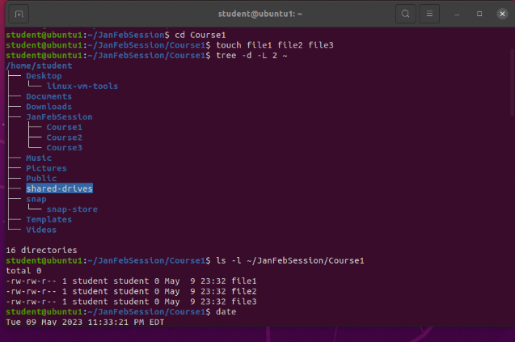
Creating directories and files

Slide 6
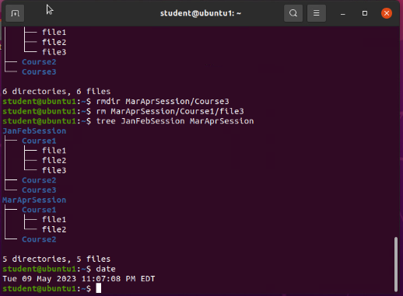
Copying and removing directories and files

Slide 7
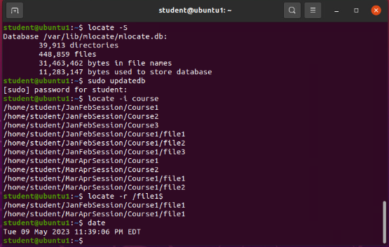
Locating directories and files

Slide 8
Linux Shell Scripts
Creating a shell script
Changing script file permissions
Setting the PATH variable
Making the PATH variable permanent

Slide 9
Creating a shell script
1. What are the file permissions of the script?
rw-rw-r--
First rw- means read and write only for the user
Second rw-means read and write only for the group members
Third r-- means read only for everyone else (“others”)
2. What’s the name of the user-defined variable in the script?
Text – “read text” means “read from the user and put input into variable called “text”
3. Which redirection meta-character is used in the script? What does it do?
>> -- means append information to the end of the file

Slide 10
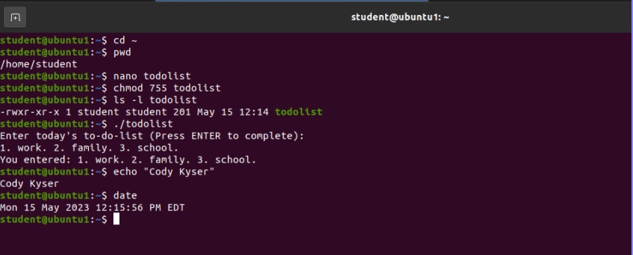
Changing script file permissions

Slide 11
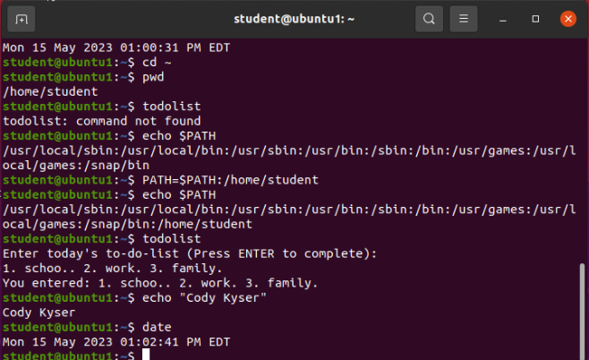
Setting the PATH variable

Slide 12
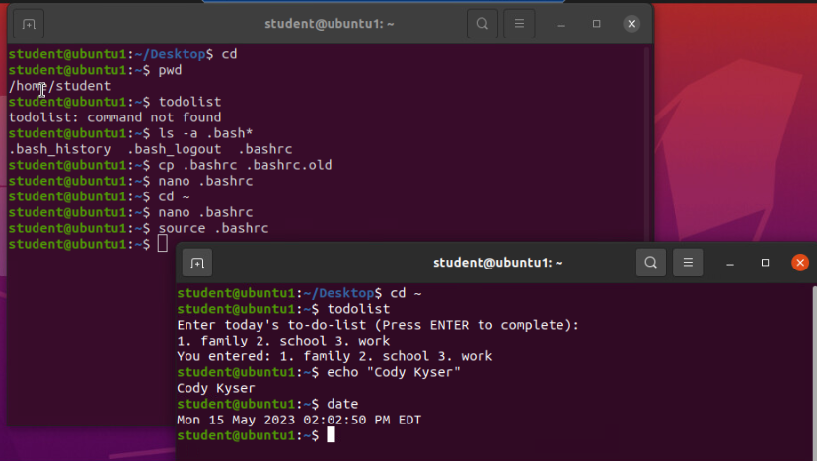
Making the PATH variable permanent

Slide 13
User and Group Management
Adding users and groups in CLI
Testing users and group settings
Adding users in GUI
Removing users and groups

Slide 14
Adding users and groups in CLI
1. What does the –m option in the useradd command do?
-m tells useradd command to create a home directory for this new user
2. What does the -3 option in the tail command do?
-3 tells tail command how many lines to show from the end of the file
3. Which line of the /etc/group file lists members of the “students” group?

Slide 15
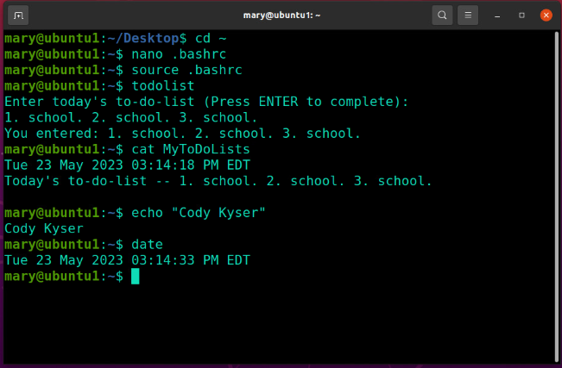
Testing user and group settings

Slide 16
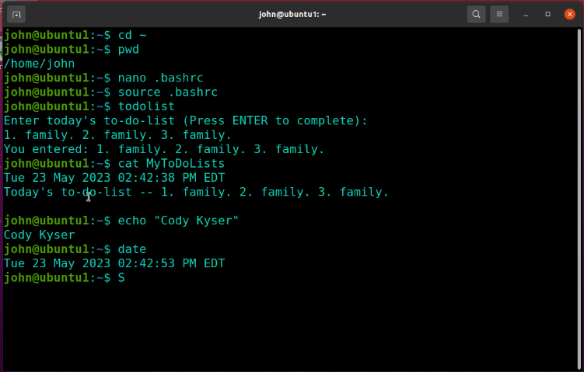
Adding users in GUI

Slide 17
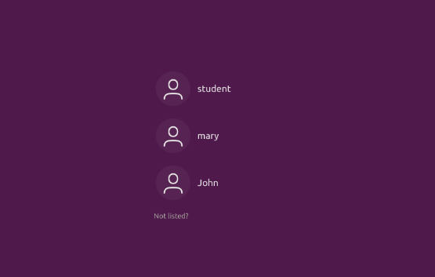
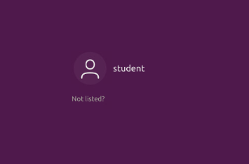
Removing users and groups

Slide 18
Network Configuration
Discovering host IP configurations
Managing network interfaces
User network utilities

Slide 19
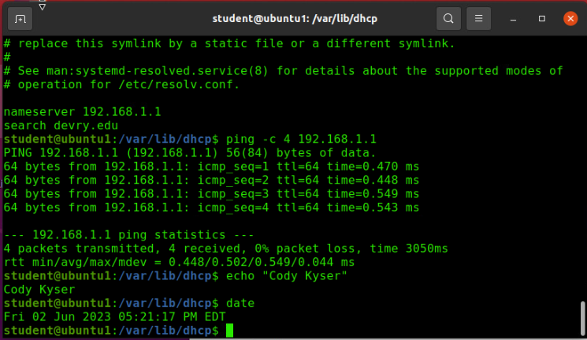
Discovering host IP configurations
1. What is the IP address of your Ubuntu machine?
192.168.1.108
2. What is the IP address of its default gateway?
192.168.1.1
3. What is the IP address of its DHCP server?
192.168.1.1
4. What is the IP address of its DNS server?
192.168.1.1

Slide 20
Managing network interfaces
1. Which DHCP message is shown in the output of the sudo dhclient –v –r ens33 command?
DHCPRELEASE
2. Which four DHCP messages are shown in the output of the sudo dhclient –v ens33 command?
DHCPDISCOVER
DHCPOFFER
DHCPREQUEST
DHCPACK

Slide 21
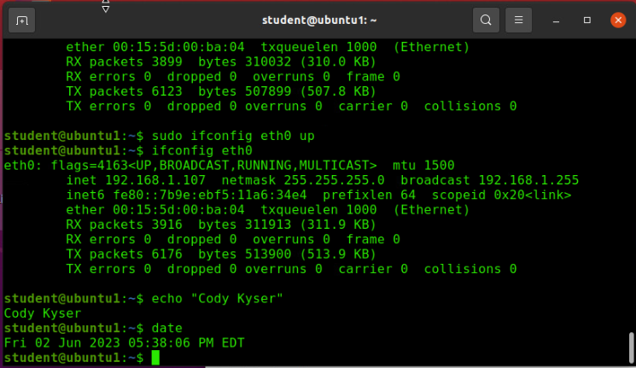
Using Network Utilities

Slide 22
System Performance Monitoring
Monitoring processes
Monitoring user activities
Monitoring network bandwidth usage

Slide 23
Monitoring Linux processes
1. What is the default action of the 15 SIGTERM kill signal?
Kill the highlighted process.
2. In the System Monitor window, click on % CPU to sort the processes by CPU load. Which process shows the highest percentage of CPU usage?
gnome-shell (GUI)

Slide 24
Monitoring user activities
Issue the sudo accton on command to turn on GNC accounting. Run the sudo updatedb command. Enter lastcomm updatedb to check if the updatedb command was executed before.
1. What flag value is displayed in the output?
S --”super user”
2. Why is the name of the user who ran the processes shown as root, not student?
superuser – since we typed sudo in front of the command

Slide 25
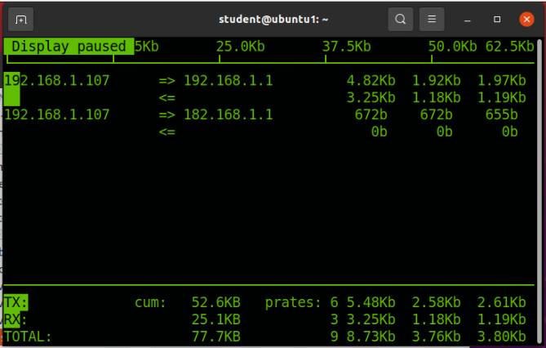
Monitoring network bandwidth usage

Slide 26
Challenges
Linux is case sensitive, unlike Windows
Remembering all of the various commands
Trial and error practicing with the command line
File systems starting at the root vs drive letters

Slide 27
Career Skills
Creating scripts for automating tasks
Learning Linux to set up corporate servers
Setting permissions for users and files
Monitoring processes and user activity
Managing network interfaces, firewalls and utilities

Slide 28
Conclusion
Linux is a great open-source, free operating system to use!
There are many distro’s of Linux, including Ubuntu, Redhat, Fedora, Rasberry Pi OS, and Arch just to name a few.
Linux is the go-to operating system for ethical hackers like Kali Linux, Parrot OS, and BlackArch

